Slide 1
Elementary data link Protocols
Lecture 12

Slide 2
Protocol
A protocol is like a set of rules that devices use to communicate with each other. It defines how data is transmitted, received, and interpreted between computers, ensuring that they can understand and work with the information they exchange.
Common protocols include TCP/IP (Transmission Control Protocol/Internet Protocol) which is used for internet communication, and HTTP (Hypertext Transfer Protocol) which is used for web browsing.

Slide 3
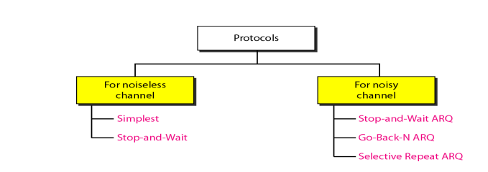
Data Link Protocols

Slide 4
Simplest Protocol
It is very simple. The sender sends a sequence of frames without even thinking about the receiver.
Data are transmitted in one direction only. Both sender & receiver always ready. Processing time can be ignored. Infinite buffer space is available. And best of all, the communication channel between the data link layers never damages or loses frames.
This thoroughly unrealistic protocol, which we will nickname ‘‘Utopia,’’ .The utopia protocol is unrealistic because it does not handle either flow control or error correction

Slide 5
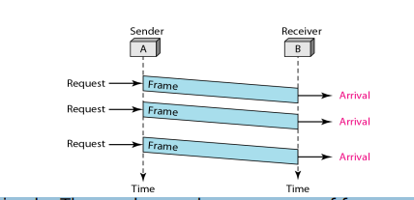
Simplest Protocol

Slide 6
Stop-and-wait Protocol
It is still very simple. The sender sends one frame and waits for feedback from the receiver.
When the ACK arrives, the sender sends the next frame It is Stop-and-Wait Protocol because the sender sends one frame, stops until it receives confirmation from the receiver (okay to go ahead), and then sends the next frame.
We still have unidirectional communication for data frames, but auxiliary ACK frames (simple tokens of acknowledgment) travel from the other direction. We add flow control to our previous protocol.

Slide 7
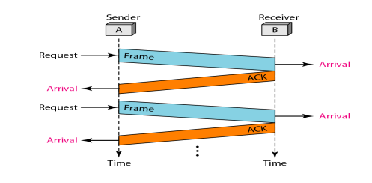
Stop-and-wait Protocol

Slide 8
Stop-and-Wait Automatic Repeat Request (ARQ)
Stop-and-Wait Automatic Repeat Request (ARQ) is a method used in computer networks to ensure reliable communication.
It works by sending a piece of data and then waiting for an acknowledgment (a confirmation) from the receiver before sending the next piece.
If the acknowledgment isn't received or is incorrect, the sender will resend the data. It's like making sure the message gets through before sending the next one.
Main Difference: To detect and correct corrupted frames, we need to add redundancy bits to our data frame. When the frame arrives at the receiver site, it is checked and if it is corrupted, it is silently discarded. The detection of errors in this protocol is manifested by the silence of the receiver.

Slide 9
Stop-and-Wait Automatic Repeat Request (ARQ)
Imagine you're sending a message to a friend using a walkie-talkie. With Stop-and-Wait ARQ, you send one piece of the message, then wait for your friend to confirm they got it.
If they didn't, you send it again. It's like saying, "Did you get that?" after each sentence. This way, you make sure your friend gets every part of the message correctly before you send the next part. It's a slow but reliable way to communicate.
A complete round in which a message receives it’s acknowledgement between sender and receiver is said to be round trip time, also It depends on bandwidth.

Slide 10
Bandwidth Delay product
The Bandwidth Delay Product (BDP) is like the maximum data traffic jam in a network.
It's found by multiplying the speed of the network by how long it takes for a message to go from one end to the other. Knowing this helps make sure data moves efficiently in the network.

Slide 11
BDP example
Suppose you have a network with a bandwidth of 1 megabit per second (1 Mbps) and a round-trip time (RTT) of 50 milliseconds (ms). How will you calculate the BDP ?
Solution:
Convert bandwidth to bits per second: 1 Mbps = 1,000,000 bits per second
Convert round-trip time to seconds: 50 ms = 0.05 seconds ( 50 ms / 1000)
Multiply bandwidth by round-trip time: BDP = 1,000,000 bits/second * 0.05 seconds = 50,000 bits

Slide 12
Go-Back-N Automatic Repeat Request
Go-Back-N Automatic Repeat Request (ARQ) is like a system where you keep sending messages one after the other without waiting for confirmation. But, if one gets lost or garbled, you'll have to resend all the messages from that point.
It's like throwing a bunch of papers and hoping they all reach the right place, but if one falls, you start over. It's fast but can use more resources.

Slide 13
The Go-Back-N Automatic Repeat Request (ARQ) uses a sliding window protocol. The key formula for Go-Back-N ARQ is:
N= 2^{n}-1
Where:
N is the size of the sender's window (maximum number of unacknowledged packets)
n is the number of bits in the sequence number field
The formula determines the maximum number of unacknowledged packets the sender can have in transit.

Slide 14
Example
Suppose we have a Go-Back-N ARQ system with a 3-bit sequence number field.
n = 3
N= 2^{n}-1
N = 7
In this case, with a 3-bit sequence number field, the sender can have up to 7 unacknowledged packets in transit before needing to stop and wait for acknowledgments. This means the sender can send up to 7 packets consecutively before expecting acknowledgments.

